Slide 1
Literature Review and Gaps Finding
Car Rental System
2310030128-Charitha
2310030267-Manasvi
2310030073-Charishma
2310030413-Sushmitha
Analyzing existing studies and identifying research gaps

Slide 2
Introduction
Car rental systems facilitate vehicle rentals for users.
Research focuses on system efficiency, pricing models, and customer satisfaction.
This review highlights existing studies, their strengths and weaknesses, and identifies research gaps.

Slide 3
Survey of Existing Studies on Car Rental Systems-Zoomcar/uber
Zoomcar is a self-drive car rental service available in multiple cities.
It allows users to rent vehicles for short or long durations without a driver.
The platform operates through a mobile app, offering flexibility and convenience.

Slide 4
Features and Functionality
category | Limitations of Existing Systems (Zoomcar, Uber, Rapido) | Project’s New Features
🔹 Security & Verification | Manual document verification delays booking approvals. | AI-Based License & ID Verification for instant approvals.
 | No strict login security, leading to unauthorized access risks. | Two-Factor Authentication (2FA) using OTP for better security.
🔹 User Management | Basic registration and profile management; limited user customization. | User Profile Management with detailed customization options.
🔹 Car Listings & Booking | Limited search filters; users struggle to find specific cars. | Advanced Search & Filters for price, location, type, and availability.
🔹 Payment & Transactions | Uber only supports card payments. | Multiple Payment Options: UPI, credit/debit cards, and net banking.
🔹 Booking Enhancements | No option for short-term or long-term rental plans. | Flexible Rental Durations (hourly, daily, monthly).
 | Customer support is slow and inefficient. | AI Chatbot for Basic Queries ensures quick responses.
🔹 Reviews & Support | No feedback/rating system for individual cars. | User Ratings & Feedback allows renters to review their experience.

Slide 5
Category | Feature | Description
🔹 Security & Verification | AI-Based License & ID Verification | Use OCR (Optical Character Recognition) to scan and verify user IDs instantly.
 | Two-Factor Authentication (2FA) | Implement OTP-based login for added security.
🔹 User Management | User Registration & Profile Management | Basic sign-up, login, and profile update functionalities.
🔹 Car Listings & Booking | Car Search & Filters | Allow users to search by car type, price, and location.
 | Real-Time Car Availability | Show available cars dynamically.
 | Instant Booking Confirmation | Send booking confirmation via email/SMS.
🔹 Payment & Transactions | Multiple Payment Options | UPI, debit/credit card, and net banking support.
🔹 Booking Enhancements | On-Demand Pickup & Drop-Off | Users can select custom locations for an extra fee.
 | Flexible Rental Duration | Allow short-term (hourly/daily) and long-term (monthly) rentals.
🔹 Reviews & Customer Support | User Ratings & Feedback | Let users rate their rental experience.

Slide 6
Technology stack
Frontend: React.js / Java Swing
Backend: Spring Boot (Java)
Database: MySQL
Authentication & Security: Google Authenticator
AI Features: OpenCV, Google Vision
Location Tracking: Google Maps API

Slide 7
DEVELOPMENT WORKFLOW
1.Requirement Gathering – Identify user needs, define features, research competitors.
2. Design & Prototyping – UI/UX design using Java Swing, wireframes, system architecture.
3. Database Setup – Configure SQLite/MySQL, design ER diagrams, implement security.
4. Backend Development – Java (Spring Boot/Servlets), authentication, payment, APIs.
5. Frontend Development – Java Swing/React.js, responsive UI, booking & payment forms.
6.Testing & Debugging – Unit & integration testing, bug fixing, user feedback.
7. Deployment & Maintenance – Cloud deployment, updates, security patches, new features.

Slide 8
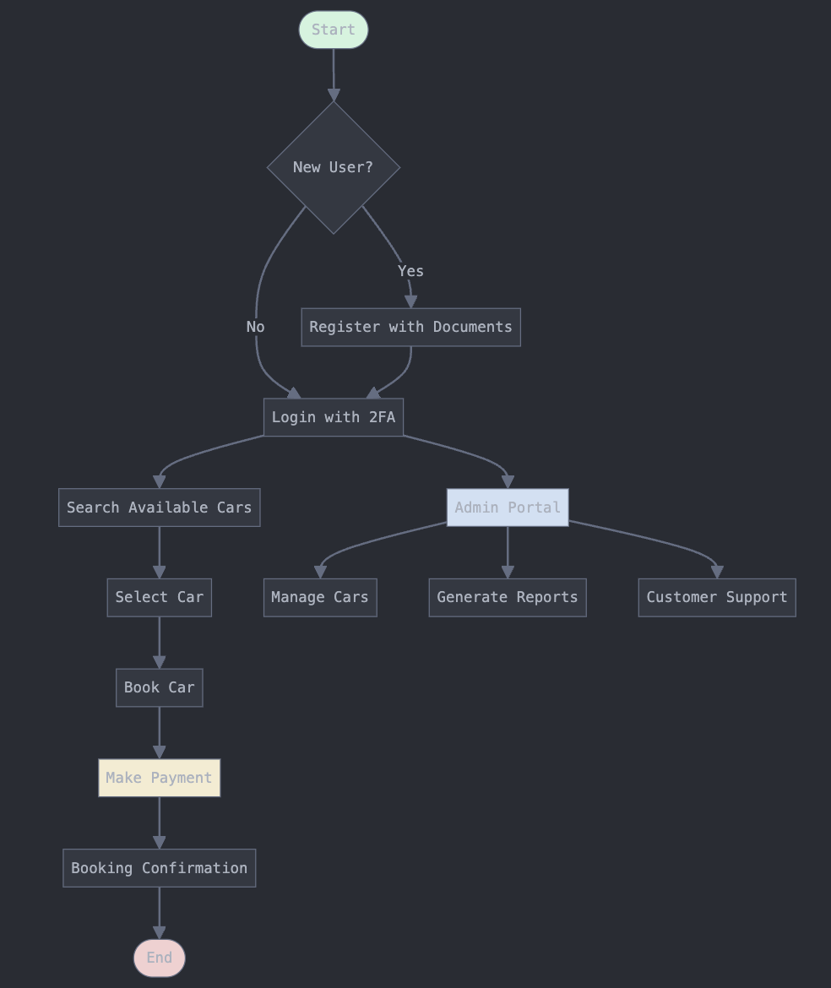
U S E C A S E D I A G R A M

Slide 9
USER FLOW DIAGRAM

Slide 10
Conclusion
Car rental systems have evolved, but gaps remain in AI, blockchain, and sustainability. Addressing these gaps can improve efficiency, security, and customer experience. Future research should focus on innovative and data-driven approaches.

